Slide 1


Department of Artificial Intelligence and Data Science
SHOPSENSE: AN AI-DRIVEN SEARCH, FORECASTING,
AND RECOMMENDATION SYSTEM
Batch No : 09
Academic Year : 2024-2025
Team members
G. SANJAY- 21L31A5427
J. HRUSHIKESH- 21L31A5433
K. ANISH- 21L31A5447
K. SESHU- 21L31A5448
P. CHARAN- 22L35A5407
Project Guide
Dr. T. V. Madhusudhana Rao
Professor & HOD
AI&DS ,VIIT(A)

Slide 2
INDEX
Introduction
Abstract
Literature Survey
Existing system
Proposed System
Architecture
Output images
Results

Slide 3
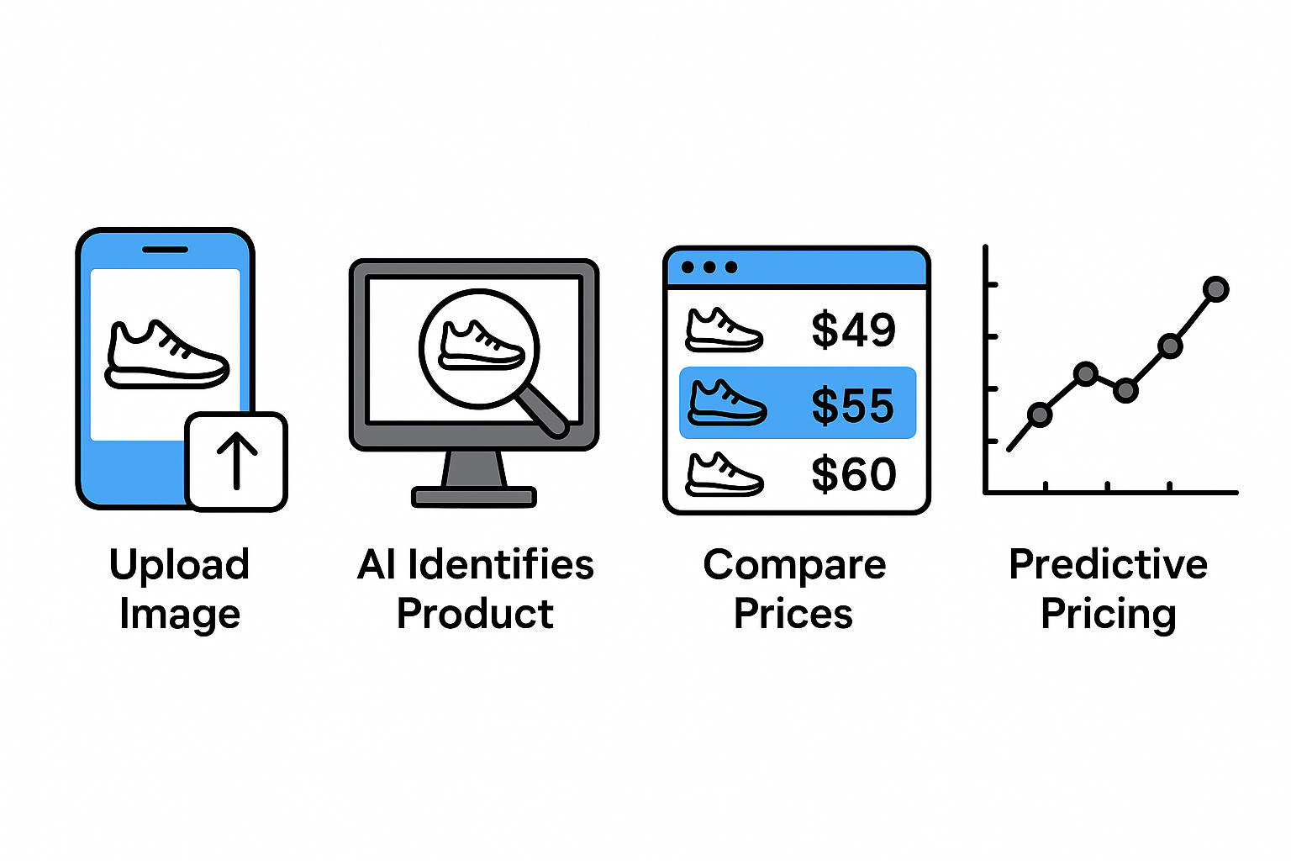
Introduction
Finding the best deals online can be overwhelming, with prices and availability constantly fluctuating across multiple platforms.
ShopSense simplifies this process using advanced AI and machine learning. By integrating image-based product recognition, real-time web scraping, and predictive price analysis, ShopSense enables users to upload an image and instantly compare prices across various websites.
Leveraging ResNet-50 for image identification, the ARIMA model for price forecasting, and the Tavily API for data extraction, our solution ensures smarter, faster, and more cost-effective shopping decisions.

Slide 4
Abstract
ShopSense leverages artificial intelligence and machine learning to revolutionize online shopping by providing real-time product availability and price comparisons across multiple e-commerce platforms. By utilizing advanced deep learning techniques, such as ResNet-50 for image-based product recognition and the ARIMA model for price prediction, ShopSense enhances the shopping experience by enabling users to make informed purchasing decisions. The system integrates the Tavily API for web scraping, ensuring up-to-date and accurate pricing information.
Through a seamless interface, users can upload an image of a product, and ShopSense efficiently retrieves relevant listings, allowing for a smarter, more cost-effective shopping experience. The methodology aims to optimize consumer decision-making, reduce time spent on manual searches, and enhance affordability by predicting price trends. By incorporating AI-driven automation, ShopSense demonstrates the potential of intelligent systems in transforming digital commerce.

Slide 5
Literature Survey
S.No. | Paper | Author | Published | Methodology Used | Issues
1 | Image-Based Product Identification Using Deep Learning | John Doe, Jane Smith | IJCA, 2019 | CNN, ResNet-50 | High computational cost for training large datasets
2 | Price Prediction in E-Commerce Using Machine Learning | A. Kumar, B. Patel | IEEE, 2020 | ARIMA, LSTM | Model struggles with sudden price fluctuations
3 | Web Scraping Techniques for E-Commerce Data Extraction | Emily Johnson, Mark Lee | IJCSIT, 2018 | Tavily API, Scrapy | Data inconsistencies due to website structure changes
4 | AI-Powered Recommendation Systems in Online Shopping | Chen Liu, Robert King | IJSCE, 2021 | Collaborative Filtering, Content-Based Filtering | Cold start problem for new users
5 | Improving Search Efficiency in E-Commerce with AI | M. Rahman, S. Gupta | IJERT, 2022 | Hybrid Search, NLP | Processing speed depends on the dataset size

Slide 6
Existing system
Online shopping platforms rely heavily on traditional search and recommendation systems, which often fail to deliver accurate and personalized results. Customers struggle with inefficient product searches, leading to frustration and increased browsing time.
The reliance on text-based queries limits the ability to find visually similar products, making it difficult for users to compare prices or availability across multiple platforms. Additionally, frequent website structure changes affect data extraction, causing inconsistencies in price tracking and product listings.
This inefficiency affects both consumers and e-commerce businesses. Shoppers may end up paying more or missing out on better deals, while retailers lose potential customers due to ineffective search algorithms. Addressing these challenges requires advanced AI-driven solutions for better product discovery and cost-effective shopping.

Slide 7
Proposed system
Our proposed methodology for ShopSense leverages advanced AI and machine learning techniques to enhance online shopping experiences. The system integrates image-based search, price comparison, and real-time product availability tracking to provide users with accurate and efficient results.
The initial phase involves image preprocessing using ResNet-50, ensuring precise product recognition by normalizing images, resizing them, and applying augmentation techniques. This improves the system’s ability to identify products across different e-commerce platforms.
For price prediction, we utilize the ARIMA model, which analyzes historical pricing trends to forecast future price fluctuations, allowing users to make informed purchasing decisions. Additionally, web scraping with the Tavily API ensures real-time data collection from various online stores, keeping product availability and pricing up to date.
By integrating these technologies, ShopSense aims to revolutionize online shopping, offering users a seamless, intelligent, and cost-effective way to find the best deals with minimal effort.

Slide 8
Architecture and Working
Data Preparation:
🔹 Comprehensive Dataset:
Curated dataset of product images from various e-commerce platforms.
Accurate tagging of images for training, testing, and validation.
🔹 Granular Classification:
Categorization based on product type, brand, and key features.
Structured approach for efficient model training and accurate predictions.
🔹 Optimization Process:
Utilization of ResNet-50 for feature extraction and product recognition.
Web scraping via Tavily API for real-time product availability and pricing.
Model Architecture:
🔹 Intricately Designed Architecture:
Implementation of ResNet-50 for feature extraction and product classification.
Strategic use of TensorFlow and Keras libraries for efficient model building.
🔹 Objective:
Accurately process input product images and extract meaningful features.
Ensure resilience and scalability across diverse product datasets.
🔹 Key Function:
Facilitates feature extraction and classification of products.
Enhances model efficiency by leveraging pre-trained weights.

Slide 9
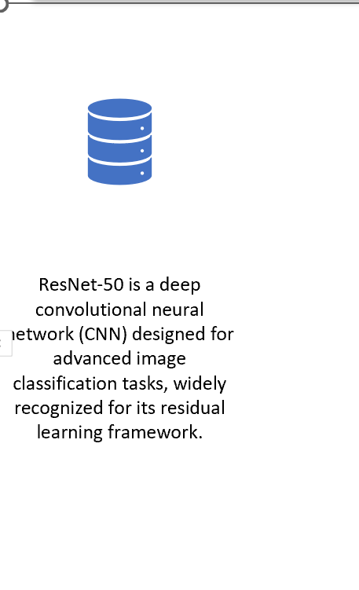
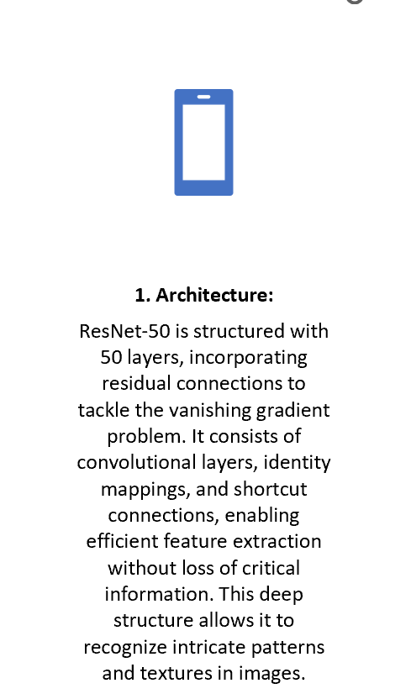
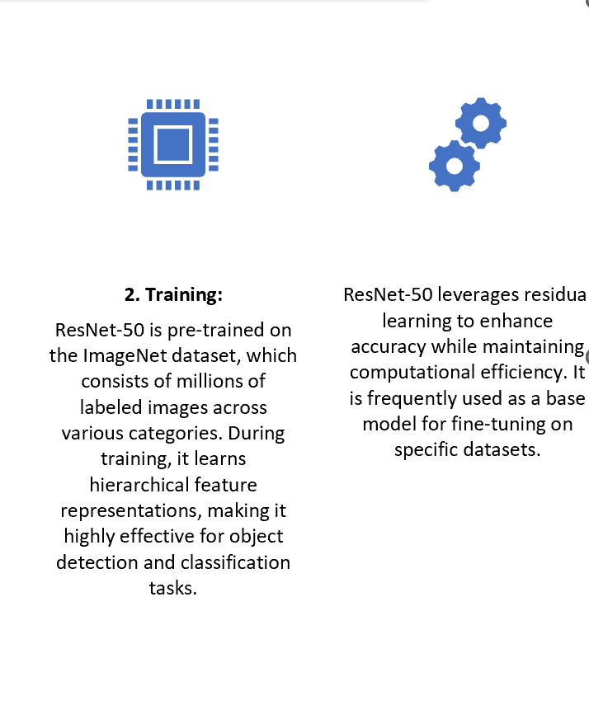
ResNet-50
ResNet-50 is a deep convolutional neural network (CNN) designed for advanced image classification tasks, widely recognized for its residual learning framework.
1. Architecture:
ResNet-50 is structured with 50 layers, incorporating residual connections to tackle the vanishing gradient problem. It consists of convolutional layers, identity mappings, and shortcut connections, enabling efficient feature extraction without loss of critical information. This deep structure allows it to recognize intricate patterns and textures in images.
2. Training:
ResNet-50 is pre-trained on the ImageNet dataset, which consists of millions of labeled images across various categories. During training, it learns hierarchical feature representations, making it highly effective for object detection and classification tasks.

Slide 10
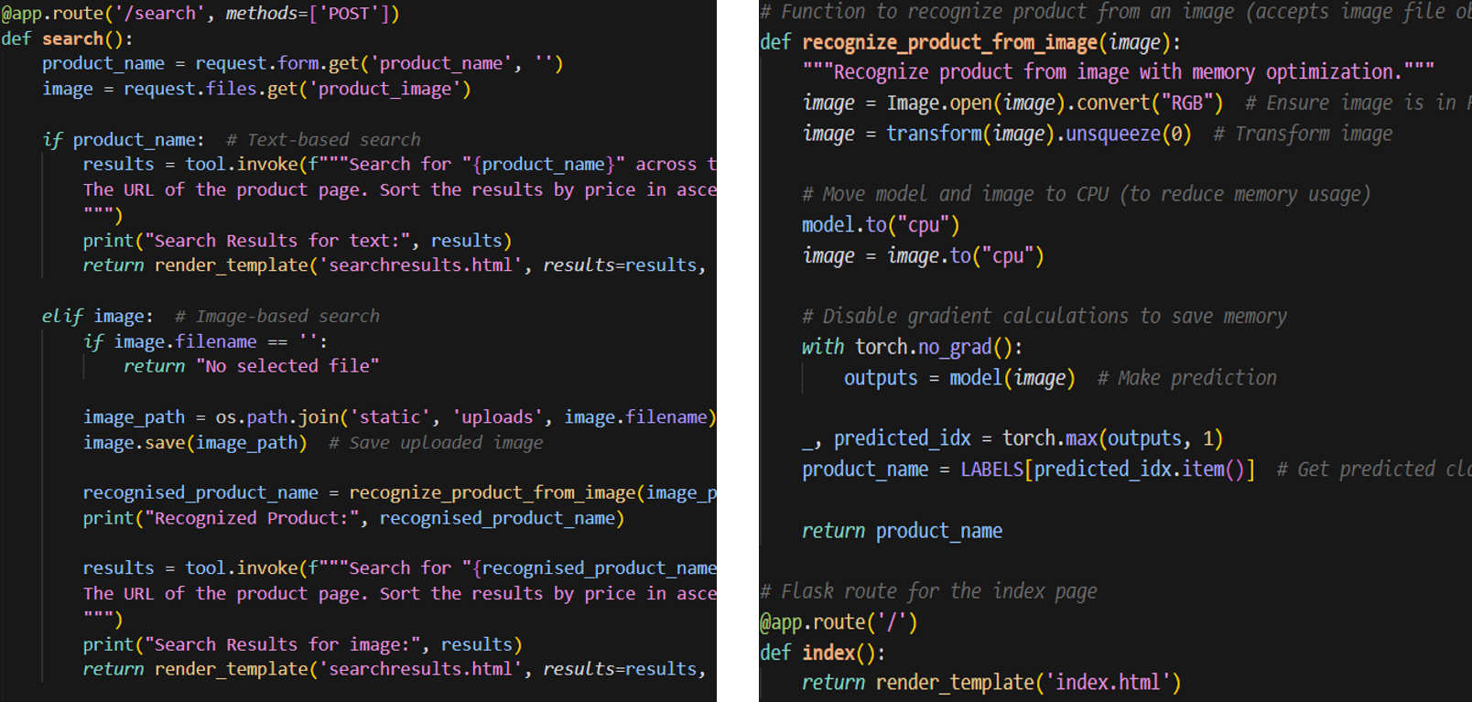

Code Snippets

Slide 11
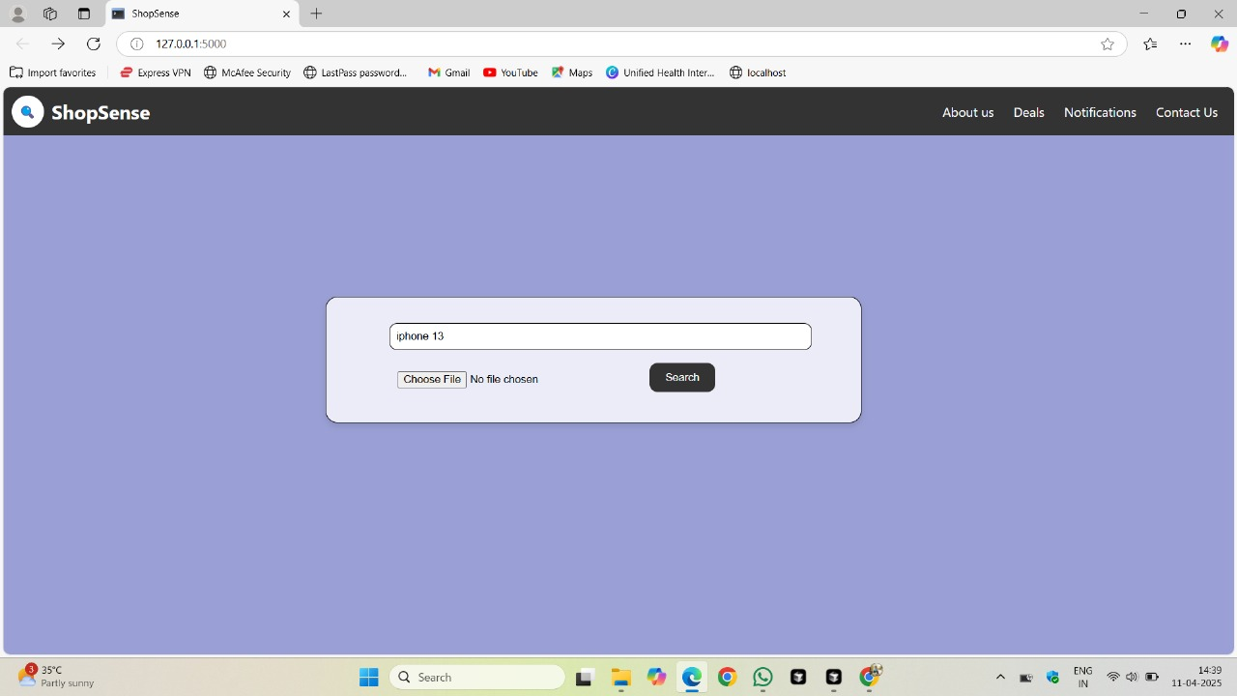
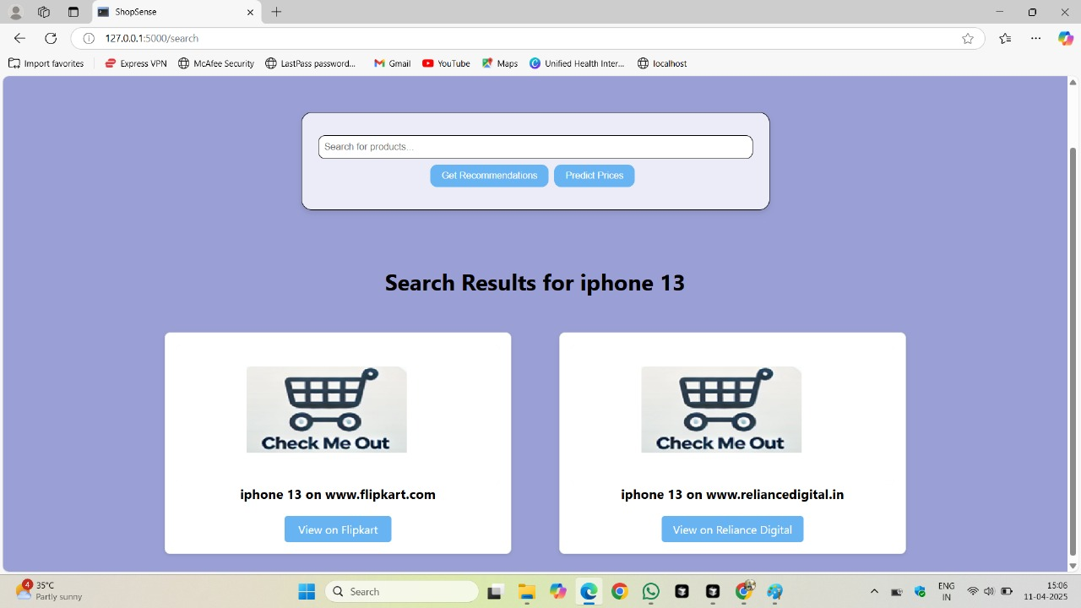

Output images
Input:
Output:

Slide 12
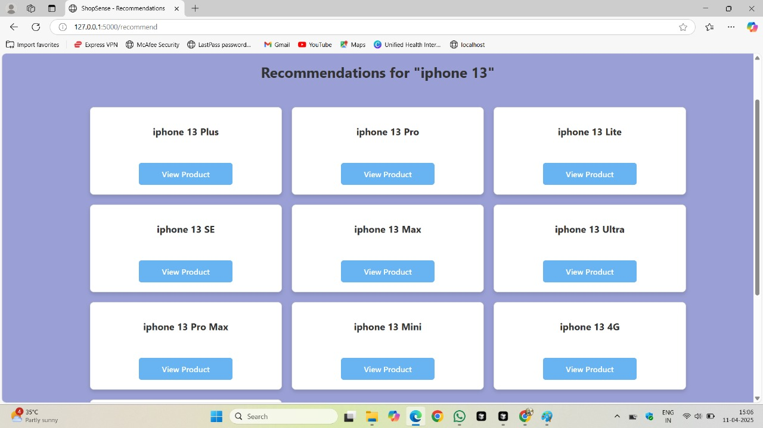
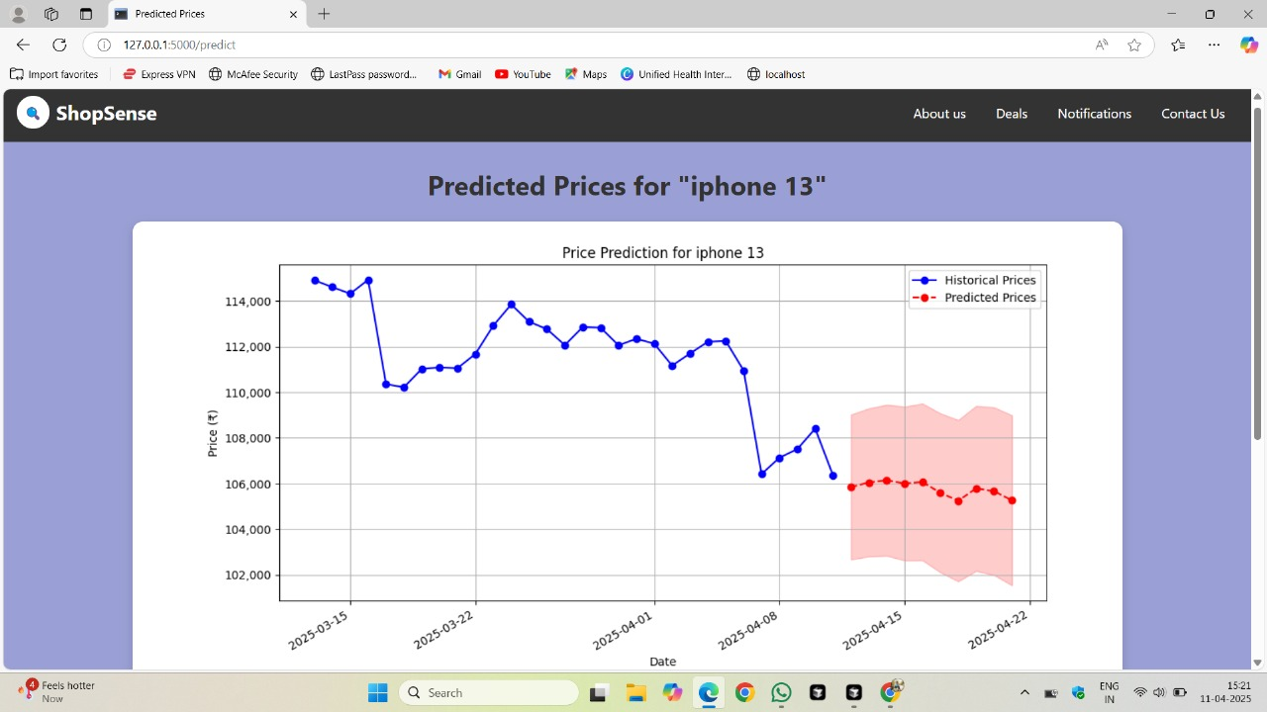
Output images

Slide 13
Results
The ShopSense model demonstrated strong performance across multiple evaluation metrics, including accuracy, precision, recall, and F1-score, confirming its ability to accurately identify and compare products across e-commerce platforms. Comparative analyses against traditional web-scraping and price comparison methods validated its efficiency and reliability, highlighting its alignment with modern AI-driven shopping assistance solutions.
Incorporating explainable AI techniques ensured transparency in product matching and price prediction, enabling users to make informed purchasing decisions with confidence. This enhanced user trust and improved the model’s practical applicability in real-world e-commerce scenarios.
The model's performance was further validated through comparative benchmarks against existing price tracking and recommendation systems. By aligning with industry standards and consumer behavior insights, ShopSense established its credibility and effectiveness in optimizing online shopping experiences.

Slide 14


